Slide 1
Automated Sleep and Activity Insights Generation
Allmin Susaiyah (ESR1),
Supervised by: Prof. Ehud Reiter and Dr. Aki Härmä,
In collaboration with:
Simone Balloccu

Slide 2
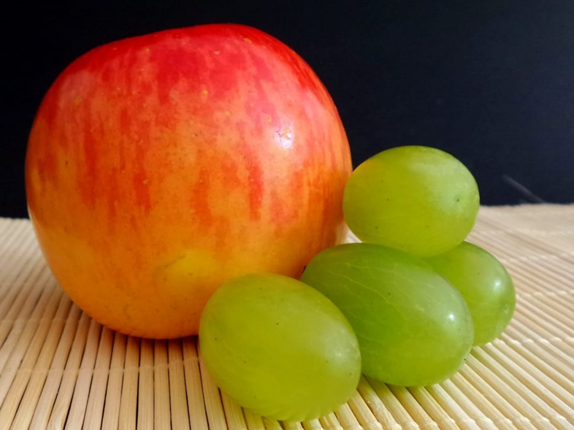
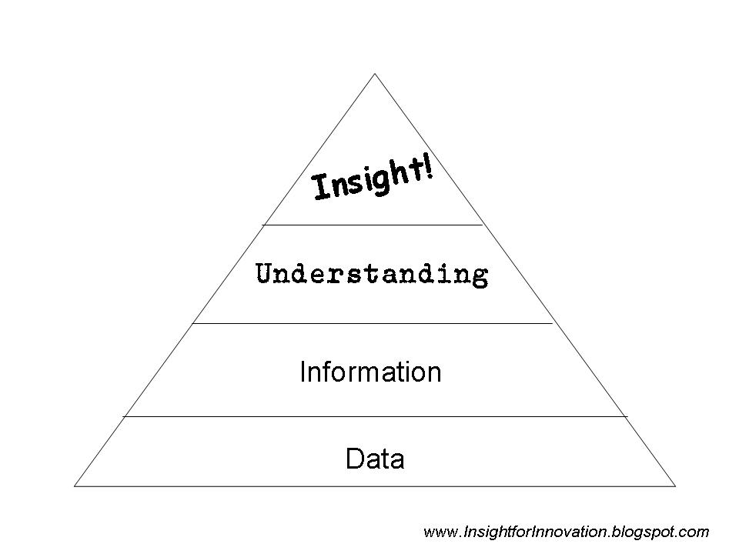
Introduction
What are Insights?
“An accurate and deep understanding”
Insights need to be ‘mined’ from data as they are of low volume and have no fixed occurrence.
Apples are bigger than grapes.
On Mondays, you sleep less than on other days.
On Fridays you burn more calories than other days.

Slide 3
How we generate the Insights
Step 1: Statement Generation
Activity​ (A)​ | Calories Burnt (C)​ | Duration (minute)​
Running | 300​ | 55​
Running | 310​ | 59​
Walking | 150​ | 58​
Walking | 140​ | 60​
Rowing | 280​ | 58​
Rowing | 290​ | 66​
While running you burnt <blank> calories than while walking.
Decide the schematic template
Step 2: Statement Scoring
While running you burnt more calories than while walking (score = 0.96)
{{Activity:1}}{{measurement}}{{Actiity:2}}
While running you burnt more calories than while rowing (score = 0.05)
Automatically generate significant insights that help to optimize campaigns

Slide 4
Sleep and Activity IG - Overview
Mi Band ^
UoA Server
Generation of Insights
Host the Chatbot
Telegram: @iphilbot
User interface
Mi fit & Google Fit
Heart Rate
Calories
Sleep Stages
Activity Minutes
Step Count
Voluntary daily sync
Android only
Send Notifications
Get Insights
Give Feedbacks
Fitness Band
Hypothesis: AI based Recommendation system can help to deliver useful insights to the user
^ This Photo by Unknown Author is licensed under CC BY-SA-NC

Slide 5
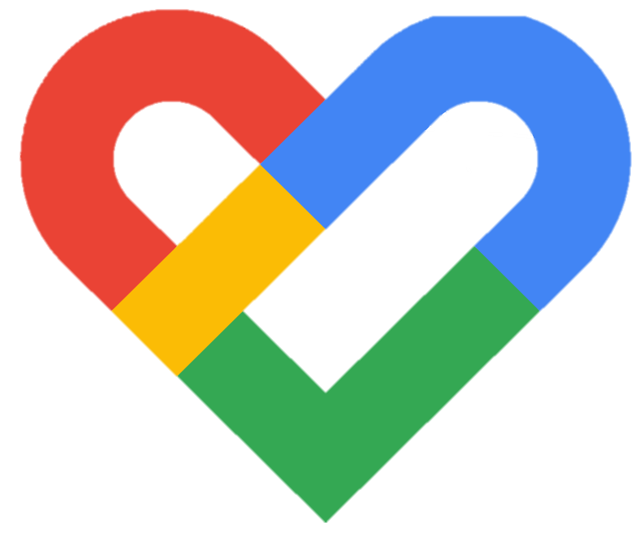
App Setup:
Google Fit
Google Fit: Activity Tracking – Apps on Google Play
Add google account in settings -> google -> Add another account
Google Fit: credentials provided
Open Google fit and choose the new user credential
Set height/weight etc as per your wish. DOB need not be very accurate.

Slide 6
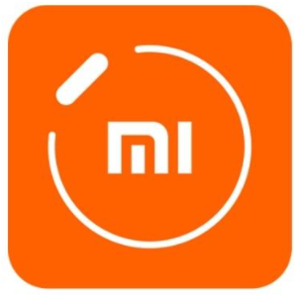
App Setup :
Mi Fit/ Zepp Life
mi fit – Android Apps on Google Play
Credentials shared personally: create a new account using the provided google id
Pair the device using “+ add device”, tap on the tick mark on the device
While-in use access
Personal Info need not be accurate, but to some
Important Settings:
Profile -> add accounts -> google fit -> login shared earlier
Profile -> My devices -> Mi Band ->Heart rate monitoring -> detection frequency : 1min
Profile -> My devices -> Mi Band ->Heart rate monitoring -> activity monitoring: on
Optional : background

Slide 7

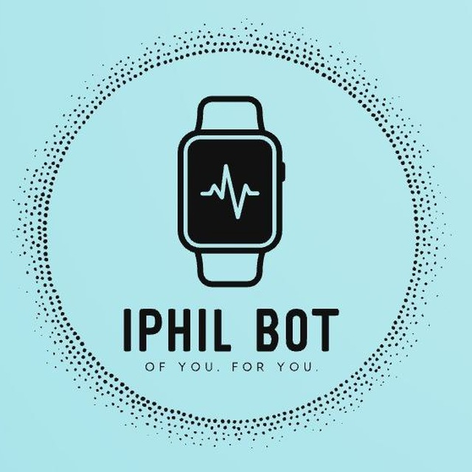
Telegram
telegram – Android Apps on Google Play
Any account username to be shared
Remember to not include contacts if you don’t want to be broadcasted
@iphilbot opens the chat bot
Say hi to get started

Slide 8
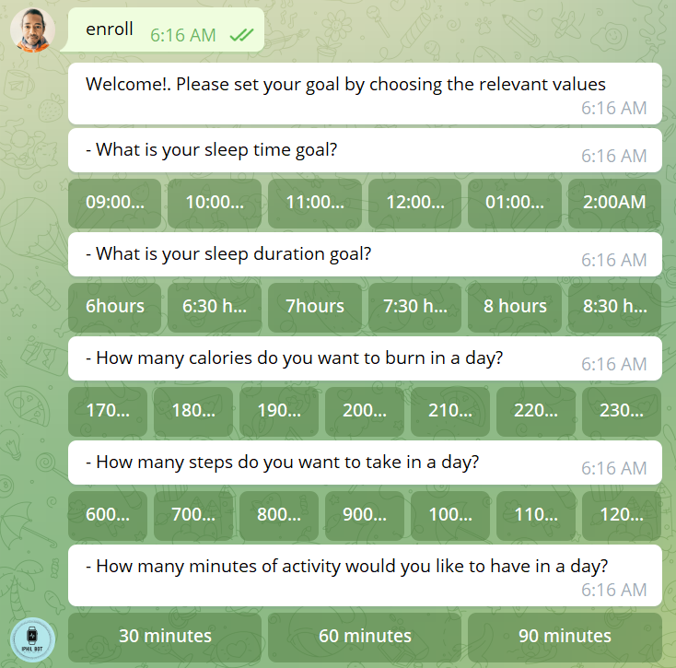
Enrollment

Slide 9
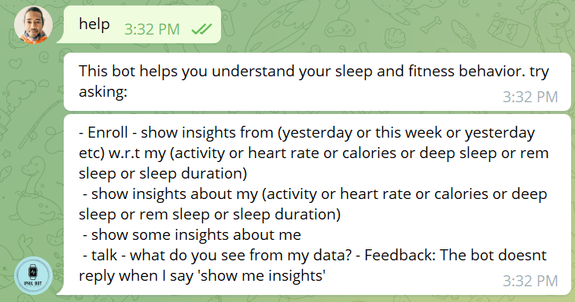
Help

Slide 10
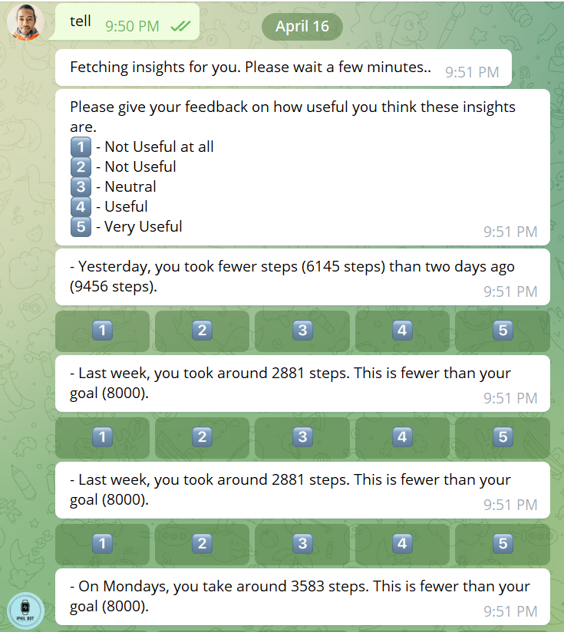
On Demand Insights

Slide 11
What’s a useful insight
Based on following conditions:
Actionable (It allows you to infer what situations let to the insight)
Measurable/Informative (It tells you measurable information about your current behaviour)
Can use to improve your lifestyle with the insight?
You can relate the insight to your lifestyle?

Slide 12
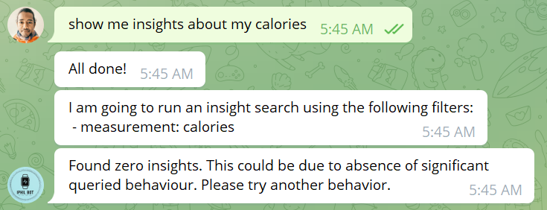
No Insights to show

Slide 13
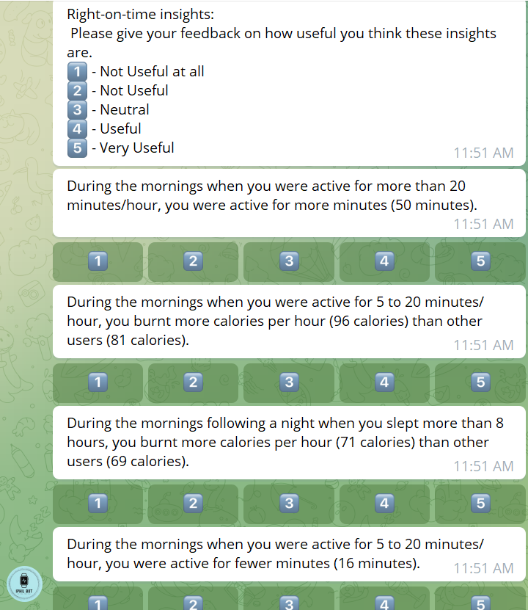
Right On Time Insights
Three times a day:
Morning
Afternoon
Evening

Slide 14
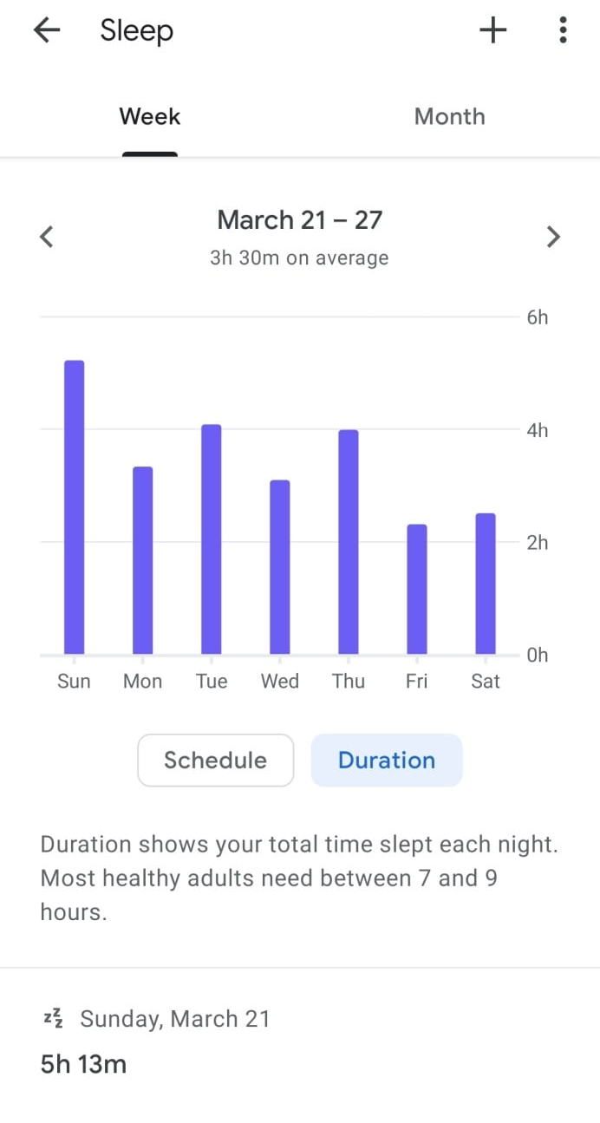
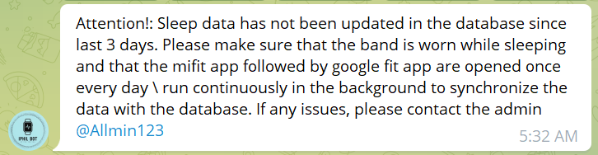
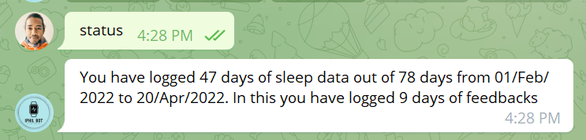
Notification: data sync
Mi Fit/ Zepp Life
Google Fit

Slide 15
Compliant participation instruction
Try to wear the band as much as possible (except unavoidable reasons)
Synch up the mobile app before sleep / 8PM every day
Or let the apps run in the background
Respond to the Right-on-time insights as much as possible
Try to give feedback at least once a day
Any doubts. complains/bugs, please contact @Allmin123

Slide 16
Token of Appreciation
20 days of data in one month of time
- > Wear the watch + give feedback + 15 Pounds Amazon Voucher
Additional 20 days of data -> 15 Pounds Voucher
You can withdraw at any time without questions. But your eligibility to keep the gift depends on when you withdraw.

Slide 17
Thank you

